Slide 1



Private Well Users:
Know Your Water
Plaistow, NH
Thursday November 03, 2016
Laurie Rardin – Dartmouth
Lou Barinelli – DHHS Public Health Lab
Paul Susca- NHDES

Slide 2
OVERVIEW
Private Wells in New Hampshire
Common Contaminants
Testing
Treatment
Community Engagement

Slide 3
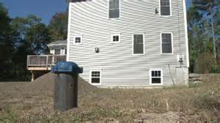
Section 1:
Private wells in New Hampshire
Notes:
Audience Question: Who regulates the testing and treating of private wells in NH?

Slide 4
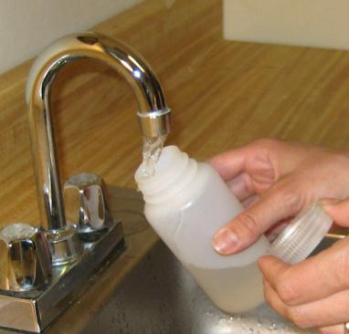
Private Wells: The Rundown
Private wells serve as a primary source of drinking water for approximately 46% of New Hampshire’s population, ~ 520,000 people.
There is no uniform testing or treatment requirement(s) for private wells in New Hampshire.
New Hampshire is a state with abundant groundwater, generally free from harmful anthropogenic contaminants

Slide 5
National Drinking Water Standards and Private Wells
  US Environmental Protection Agency (EPA) regulates public water systems;
  EPA does not have the authority to regulate private drinking water wells.
  Approximately 15 percent of Americans rely on their own private drinking water supplies, and these supplies are not subject to EPA standards, although some state and local governments do set rules to protect users of these wells.

Slide 6

Municipalities That Require Private Well Testing
Bow, Derry, Pelham, Salem, Windham, Chester
  Require testing to receive a CO (Bow)
  Cite RSA 147:1 Public Health Authority
  Refer to DES’s Standard Analysis (tests)
  Most require water quality testing
  (w/o treatment) vs. treatment
Defining “potable” could change that

Slide 7
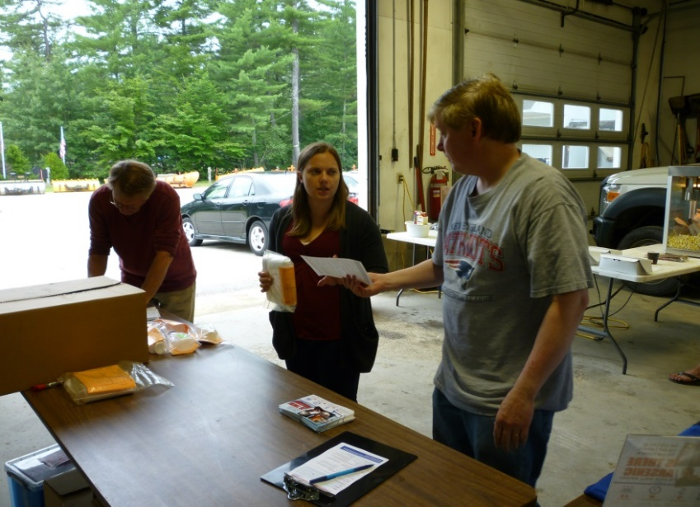
Section 2
Common
Contaminants

Slide 8
Contaminants
can be both
naturally occurring
and/or
human caused

Slide 9
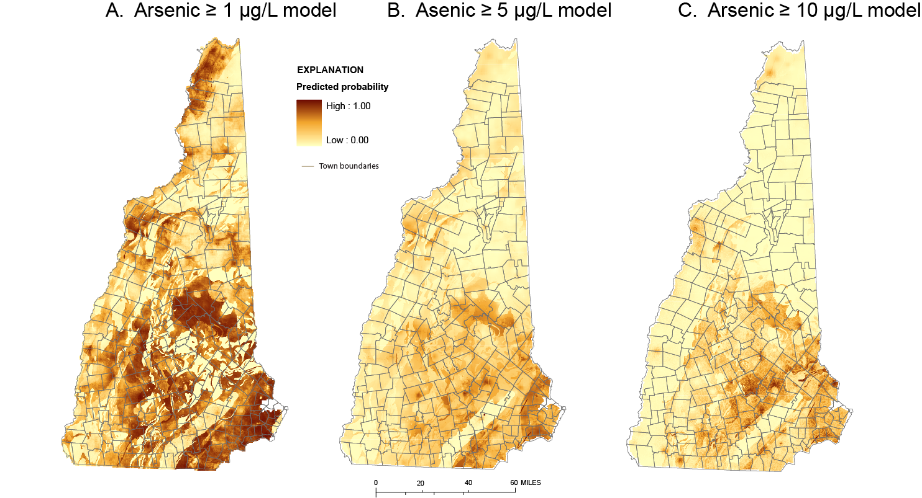

Probability of Arsenic in New Hampshire
Arsenic is an example of a naturally occurring contaminant

Slide 10
Human-Caused Contaminants
  Petroleum components – MtBE
    ~23% (1 in 4) of samples thus far with detectable levels
  PFC compounds
  Teflon®, Post-It® and other adhesive paper, Cosmetics, Tyvek®, Gore-Tex® or other synthetic and stain-resistant materials
    ~ 170 wells above health advisory thus far

Slide 11
Common Contaminants in New Hampshire Private Wells
PARAMETER |  | Percent of Private Well samples above Health Standard
Arsenic | 10 µg/L | 20%
Bacteria | Present | 19%
Lead (stagnant)* | 15 µg/L | 70% detects | 15% exceeding
Lead (flushed)* | 15 µg/L | 31% detects | 2% exceeding
Nitrate | 10 mg/L | 0.3%
Radon** | 2,000 pCi/L | 55%
Radon** | 10,000 pCi/L | 24%
Manganese | 0.05 mg/L | 40%
Lead Stagnant = first flush sample sitting overnight in home plumbing.
Lead Flushed = samples after flushing tap for a few minutes.
Source: NHDES, Drinking Water & Groundwater Bureau, 2016

Slide 12
Health Impacts - Arsenic
Low dose, chronic, long term exposure increases risk of:
  Cancers (bladder, skin, kidney, liver, prostate and lung)
  Vascular and cardiovascular disease
  Reproductive and developmental effects
  Cognitive and neurological effects
  Diabetes and other metabolic disorders
  Neuropathy
  Hughes et al. (2011). “Arsenic Exposure and Toxicology:
  A Historical Perspective” Toxicological Sci 123(2): 305–332.
Notes:
Arsenic is highly toxic—and a known carcinogen—in many of its chemical forms.
Arsenic is the number one substance in the most recent CERCLA Priority List of Hazardous Substances published by the ATSDR, which are substances ranked on frequency, occurrence, toxicity, and potential for human exposure.
The International Agency for Research on Cancer (IARC) lists "arsenic and arsenic compounds" in group 1, which is a list of chemicals and groups of chemicals that are causally associated with cancer in humans.
The World Health Organization produced a 2010 report titled: “Exposure to Arsenic: A Major Public Health Concern.”
Both epidemiological and laboratory studies conducted over the last 10-20 years have sought to determine what level of arsenic creates toxicological and public health concerns. A major study in Bangladesh, the Health Effects of Arsenic Longitudinal Study (HEALS), relates exposure to relatively high levels of arsenic to all-cause, chronic disease.
Evidence shows a causative link between arsenic and bladder, skin, kidney, liver, and lung cancer.
Arsenic exposure and metabolic diseases:
Changes in serum cholesterol and triglycerides
Development of type 2 diabetes and other metabolic disorders (type 2, non-insulin-dependent, “adult-onset”)
Lower than normal birth weights
Decreases in body weight and growth during early childhood
Vascular and cardiovascular disease
Arsenic affects all five steroid hormone receptors:
Estrogen Receptor
Progesterone Receptor
Androgen (Testosterone) Receptor
Glucocorticoid (Cortisol) Receptor
Mineralocorticoid (Aldosterone) Receptor
Arsenic affects other nuclear hormone receptors:
Retinoic Acid Receptor
Thyroid Hormone Receptor
PPAR Receptors
What is an endocrine disruptor?
“Collectively, chemicals with the potential to interfere with the function of endocrine systems are called endocrine disrupting chemicals (EDCs). EDCs have been defined as exogenous agents that interfere with the production, release, transport, metabolism, binding, action, or elimination of the natural hormones in the body responsible for the maintenance of homeostasis and the regulation of developmental processes.” Strategic Research Plan for Endocrine Disruptors, 1998, Office of Research and Development, U.S. EPA
Developing fetuses, infants and children are particularly vulnerable. Developing fetuses can be exposed to arsenic because it crosses the placenta.
New epidemiological studies use maternal urinary arsenic (a biomarker of recent exposure) to link arsenic to diseases.
Laboratory studies show that low doses of arsenic disrupt the activity of a hormone critical in development.
Epidemiological studies link maternal urinary arsenic (a biomarker of recent exposure) to infant mortality and low birth weight.
Other findings show in utero arsenic exposure can hamper immune function and increase mortality from lung cancer and non-cancer lung diseases later in life.
Finally, ongoing research suggests that exposure to arsenic in early life (including gestation and early childhood) may increase susceptibility to cancer in adulthood.
Some of these effects can occur even at very low doses:
10-50 ppb in some human cancer studies
5-50 ppb in human cognitive studies
1-10 ppb in animal studies
Knowledge gaps. Little is known about:
Ways to ameliorate or reverse health effects in exposed individuals or populations;
Other potential adverse health effects of arsenic not previously studied or recognized;
Other at-risk or uniquely sensitive sub-groups;
The relative susceptibility of fetuses and young children to arsenic; and
Exposure to inorganic arsenic in food

Slide 13
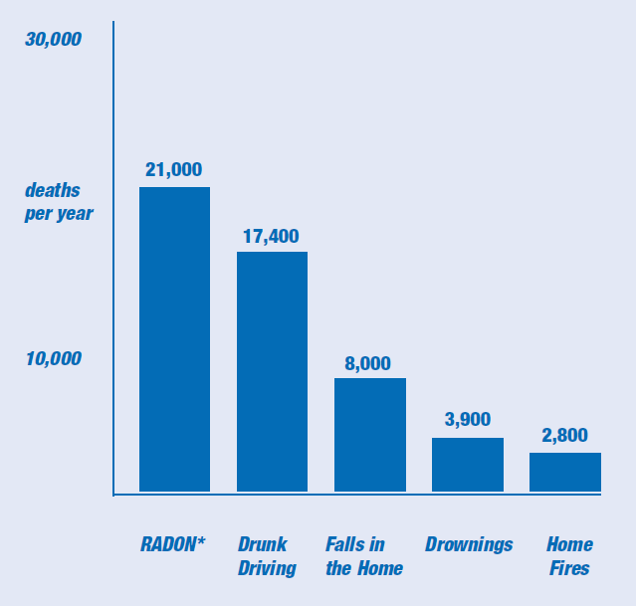
Health Impacts - Radon
Radon (air)
  21,000 lung ca deaths/yr in U.S.
  100 deaths/yr in NH!!
Most of the risk from radon in water comes from breathing radon gas that is released into the air when water is used in the home.
Notes:
21 K is from EPA
Radon in NH is from NHDHHS EPHT
As from Dartmouth 2014 – more on this later

Slide 14
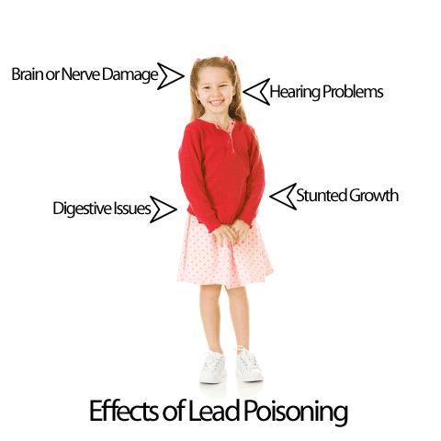
Health Effects for Common Well Water Contaminants
E.coli Bacteria / Fecal Contamination
Diarrhea, vomiting, death! Vulnerable population most at risk.
Nitrate
Infants under six months “blue-baby syndrome” (methemoglobinemia), coma and death.
Lead
Infants and Children most vulnerable, irreversible, developmental, behavioral health effects
Notes:
Long-term exposure to radon contributes to the deaths of an estimated 100 New Hampshire residents each year, making it the second leading cause of lung cancer. If you haven’t already done so, you should also test the air in your home for radon gas if you live below the third floor.

Slide 15
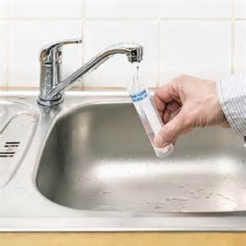
Section 3
Testing

Slide 16

New Hampshire Public Health Laboratories
Principle Laboratory for the State of New Hampshire
Support Department of Environmental Services in administering and enforcing federal Safe Drinking Water Act
  Maintain accreditation, capability and capacity to analyze all primary drinking water parameters in the event of an emergency or enforcement action.
Notes:
11/10/2016 9:31 AM
© 2007 Microsoft Corporation. All rights reserved. Microsoft, Windows, Windows Vista and other product names are or may be registered trademarks and/or trademarks in the U.S. and/or other countries.
The information herein is for informational purposes only and represents the current view of Microsoft Corporation as of the date of this presentation. Because Microsoft must respond to changing market conditions, it should not be interpreted to be a commitment on the part of Microsoft, and Microsoft cannot guarantee the accuracy of any information provided after the date of this presentation.
MICROSOFT MAKES NO WARRANTIES, EXPRESS, IMPLIED OR STATUTORY, AS TO THE INFORMATION IN THIS PRESENTATION.
16

Slide 17
What to Test
NH DES Standard Analysis and Radiological Analysis
Additional Tests for Private Wells
Volatile Organic Chemical (VOCs)
  Gasoline Related Compounds (MTBE)
  Chlorinated Solvents
Semi-Volatile Organics
  Petroleum Hydrocarbons
  Pesticides/Herbicides
Notes:
At this time show what the standard test kit looks like and demonstrate how to collect a sample.

Slide 18

When to Test
Other times to test your water:
Follow the NH DES Well Testing Schedule
If the well flooded
If you notice a change in the color, taste or smell of your well water

Slide 19
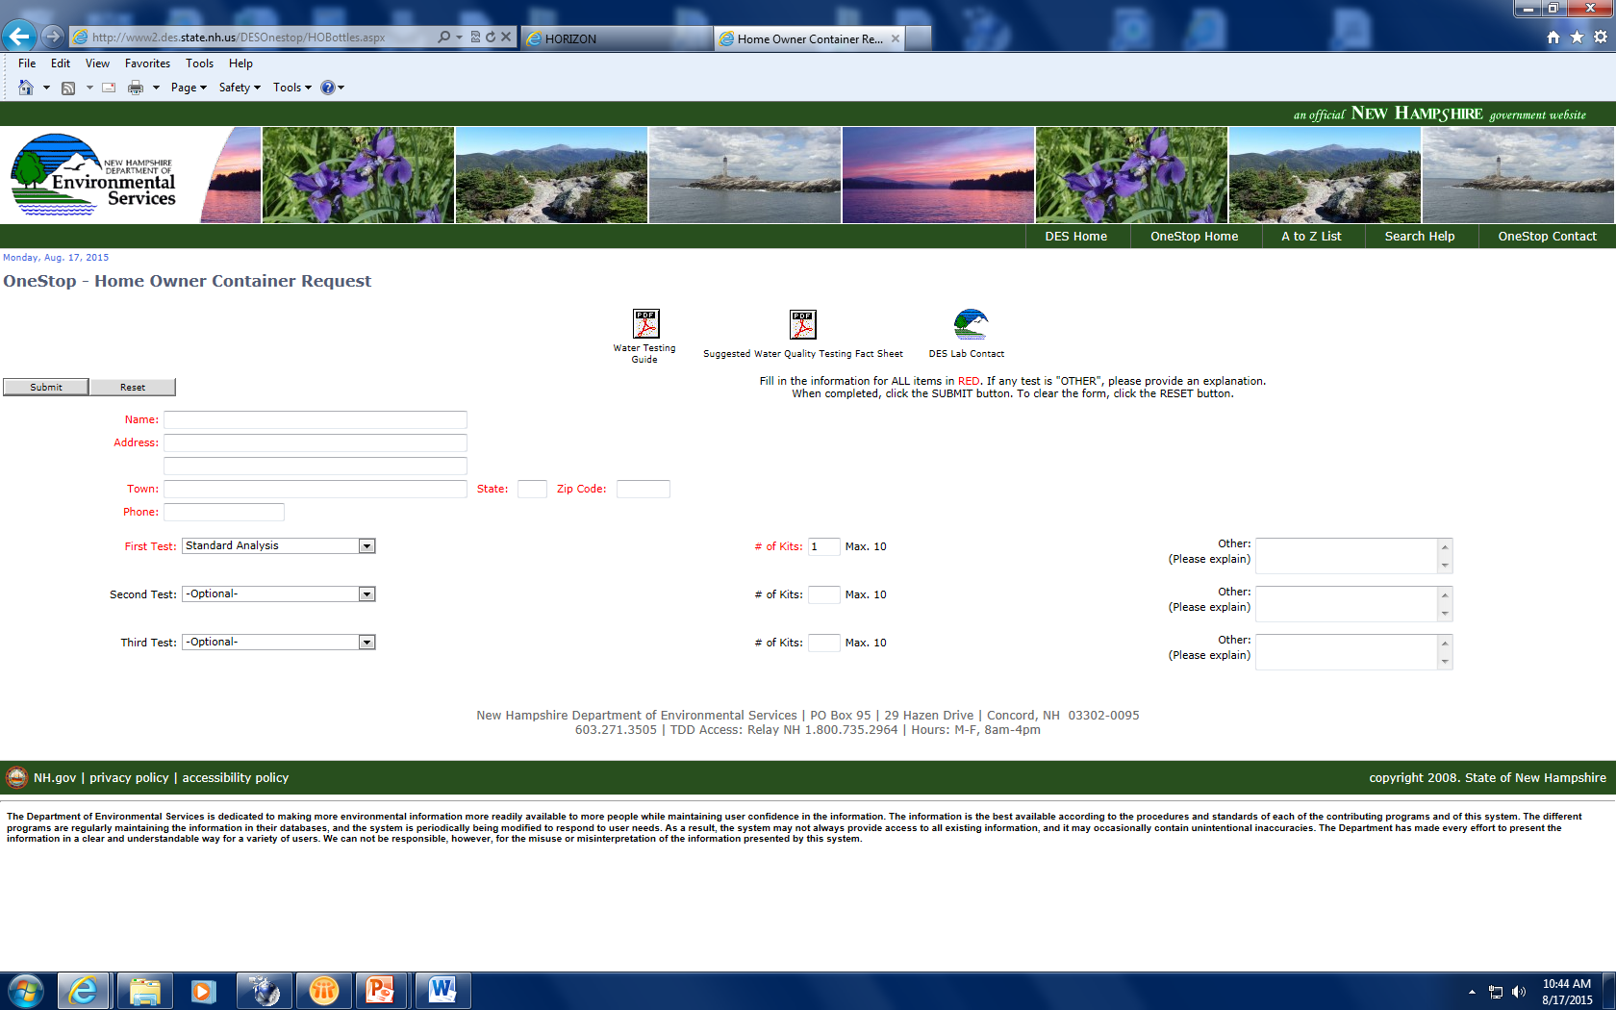


Where to test
Accredited Testing Laboratories
Notes:
11/10/2016 9:31 AM
© 2007 Microsoft Corporation. All rights reserved. Microsoft, Windows, Windows Vista and other product names are or may be registered trademarks and/or trademarks in the U.S. and/or other countries.
The information herein is for informational purposes only and represents the current view of Microsoft Corporation as of the date of this presentation. Because Microsoft must respond to changing market conditions, it should not be interpreted to be a commitment on the part of Microsoft, and Microsoft cannot guarantee the accuracy of any information provided after the date of this presentation.
MICROSOFT MAKES NO WARRANTIES, EXPRESS, IMPLIED OR STATUTORY, AS TO THE INFORMATION IN THIS PRESENTATION.
19

Slide 20
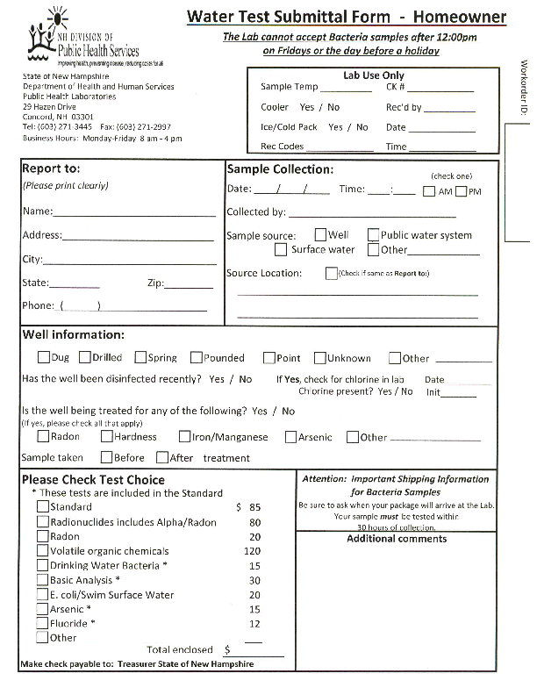
How to Test:
Sample Water Test Submittal Form
Notes:
11/10/2016 9:31 AM
© 2007 Microsoft Corporation. All rights reserved. Microsoft, Windows, Windows Vista and other product names are or may be registered trademarks and/or trademarks in the U.S. and/or other countries.
The information herein is for informational purposes only and represents the current view of Microsoft Corporation as of the date of this presentation. Because Microsoft must respond to changing market conditions, it should not be interpreted to be a commitment on the part of Microsoft, and Microsoft cannot guarantee the accuracy of any information provided after the date of this presentation.
MICROSOFT MAKES NO WARRANTIES, EXPRESS, IMPLIED OR STATUTORY, AS TO THE INFORMATION IN THIS PRESENTATION.
20

Slide 21
Summary Data for Private Wells in Plaistow 2006-2016
 | Arsenic mg/L | Radon pCi/L | Radon pCi/L | Total Coliform P-A/100mL | E. coli P-A/ 100mL | Manganese mg/L | Iron mg/L | Lead Stagnant mg/L | Lead Flushed mg/L
Standard | 0.010 | 2000 -10000 | >10000 | Absent | Absent | 0.05 | 0.3 | 0.015 | 0.015
Total Samples | 101 | 15 | 15 | 121 | 121 | 92 | 93 | 89 | 92
Detects | 77 | 15 | 15 | 21 | 10 | 52 | 50 | 49 | 23
Above Standard | 39 | 9 | 1 | 21 | 10 | 34 | 9 | 5 | 0
Above Standard % | 39% | 60% | 7% | 17% | 8% | 37% | 10% | 6% | 0%

Slide 22

Section 4:
Treatment

Slide 23
Dartmouth Private Well Survey (2014)
1 in 4 people who tested their well did not understand the results of their lab report.
1 in 3 did not know what actions to take given their water quality test results.

Slide 24
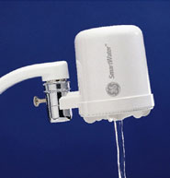
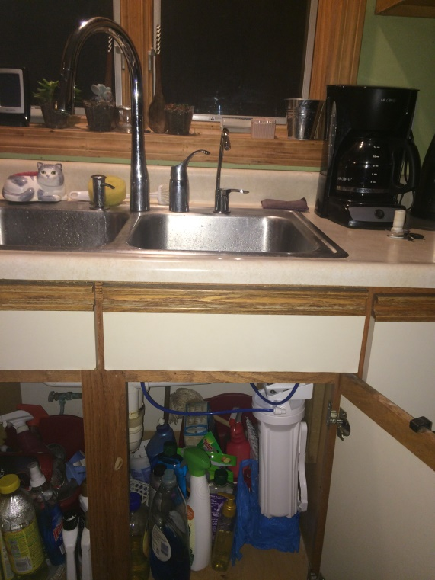
Home Water Treatment – Point of Use (POU)
Treats water at a single tap, examples:
POU carbon filter ->
<- POU Arsenic
Contaminants treated at Point of Use:
  Arsenic
  Uranium
  Fluoride
  Radium
  Chlorine

Slide 25
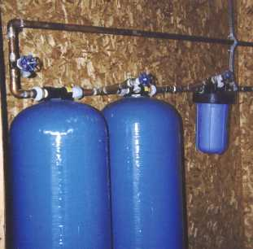
Home Water Treatment – Whole-House
Treats all the water entering the house and is installed in the basement.
Whole House treatment is necessary for:
  Radon
  Iron, Manganese
  Lead and Copper Corrosivity
  Odor - Sulfide
  Scaling- Hardness

Slide 26
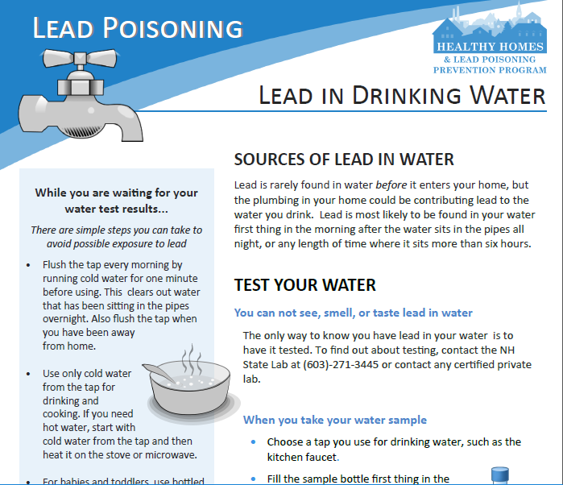
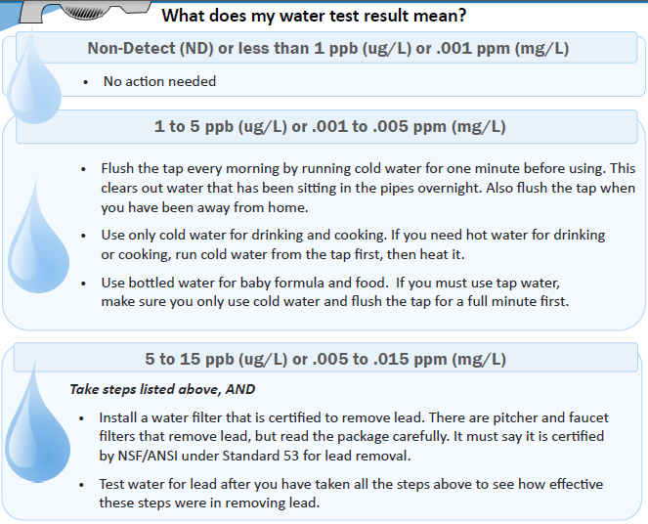
Understanding Lead
MCL Goal is ZERO
Flush your tap every morning before using water for consumption
Test stagnant lead and copper to know if your water is corrosive to your home plumbing
Use alternate water for infants and children if levels are above 5 ppb

Slide 27
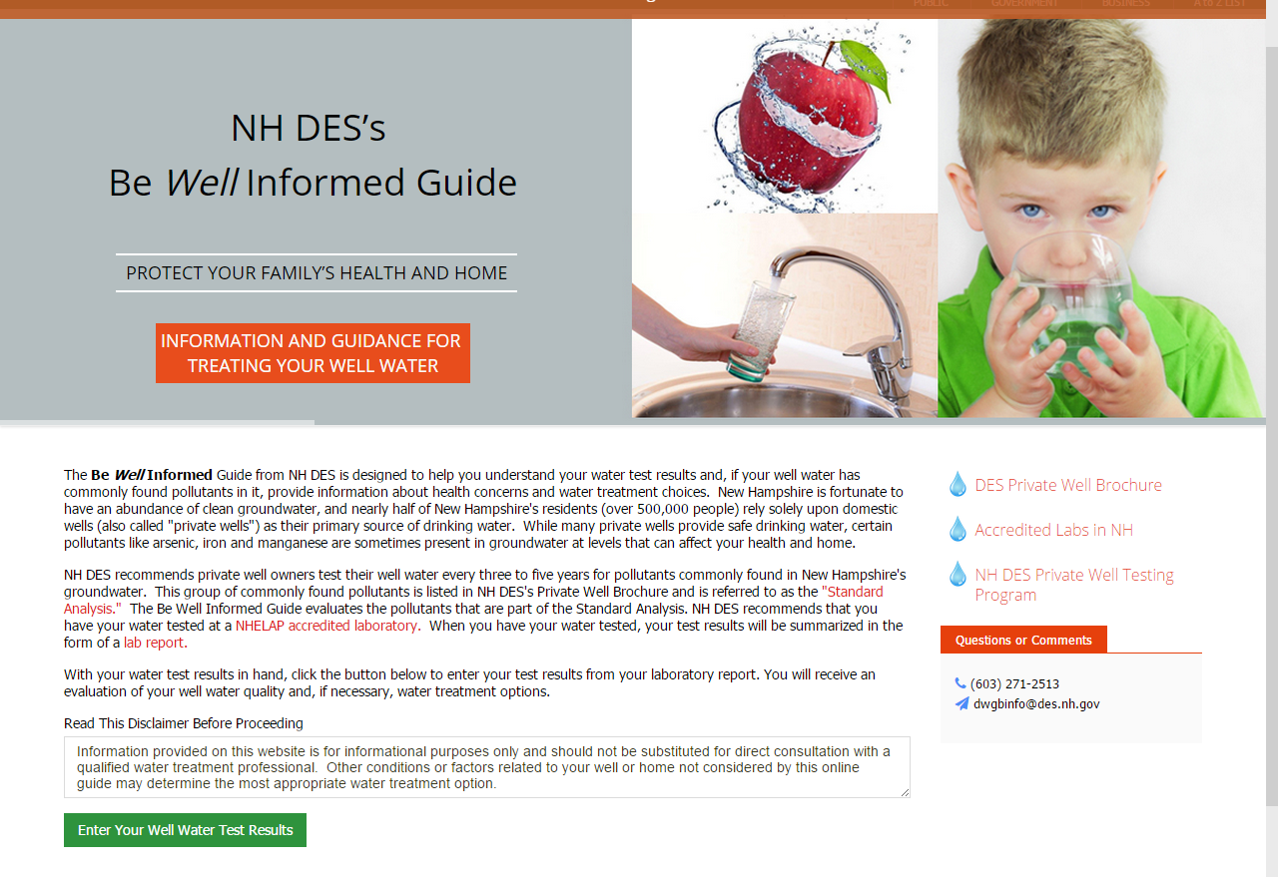
NHDES Be Well Informed Web Tool
  Provides an interpretation of lab results in terms of water quality standards
  Provides applicable treatment technologies to address contaminants of concern
  Provide information on health effects
  Considers multiple contaminants
Notes:
Slide

Slide 28
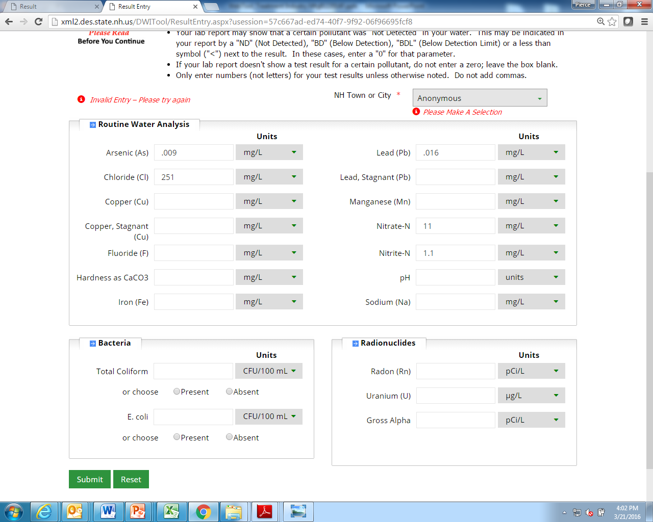
Be Well Informed user entry form is designed around the “standard analysis” recommended by NHDES
Notes:
BWI requires a lab report that the user must use to type in the results for one or a number of contaminants.

Slide 29
Printable Web App Report:
Part 1: “Results Summary”
Notes:
The product of the BWI app is a report that well users can save, print out and discuss with a treatment vendor. It’s composed of three parts. Part 1 is the “results summary.” this provides an overview of what values user entered or did not enter, where they fall against the standard or guideline, and a short statement, such as, “the value entered is above the standard or guideline, or it meets the standard/guideline.
The final report uses icons to help illustrate to the user what the result means, (a red X is not good) and it’s short and to the point.

Slide 30
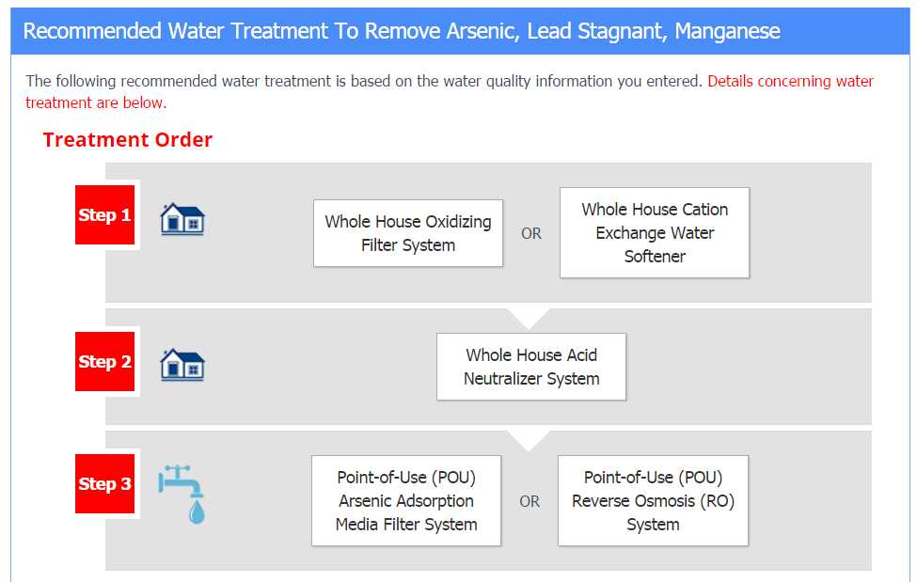
Part 2: Treatment “Train”
Notes:
Part II is referred to as the treatment train. It presents one or multiple technologies in proper sequence to address the contaminants entered.
The programming logic that determines the treatment technologies are then evaluated and presented so that the optimal set of treatment technologies are listed in the train (e.g., one treatment may treat several contaminants vs. a different treatment only treats 1) in the order they would typically be installed in a residential structure.

Slide 31
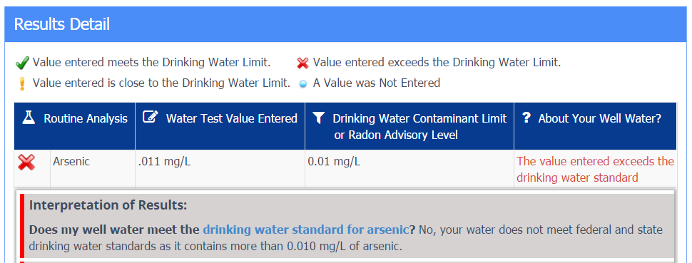
Part 3: Interpretation, Health, Treatment
Notes:
The Results Detail section contains narrative interpret the water test results (recall the questions NHDES gets)_, providing an overview of known public health concerns when appropriate, and the correct treatment technologies. The language is brief, reflecting the need to get only the essential information to the well owner. There are links to other sites for additional information.

Slide 32
Be Well Informed Treatment Recommendations
Recommends appropriate treatment technologies, not products.
Addresses treatment for common contaminants (Standard Analysis)
Considers one or multiple contaminants at varying concentrations, and well owner feedback (e.g., staining, taste)
Yields printable PDF reports
Provides links and offers phone support from DES
  Homeowners may find the BWI link on their lab reports or on the website of their accredited lab, or search for “NHDES Be Well Informed”

Slide 33
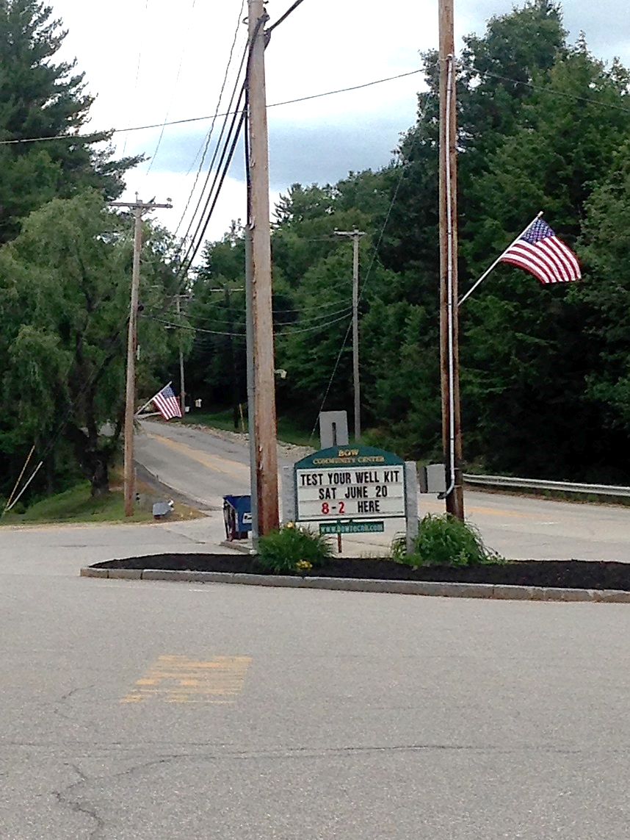
Section 5:
Engaging Your
Community

Slide 34
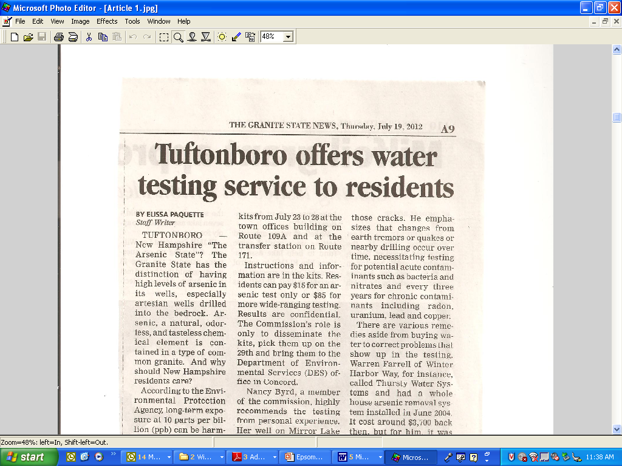
Impact of Community Outreach
A 2014/2015 NH DES/Dartmouth study showed town testing events were effective at increasing testing when preceded by town communications. Testing events held in isolation were ineffective at increasing testing.
Conservation Commission distributed 172
test kits to the public

Slide 35
Community Toolkit
Toolkit Table of Contents
    Introduction
    Where should you start?
    Creating a plan that works for you and your community
      Assessment
      Capacity Building
      Planning
      Implementation
      Monitoring
    Additional Resources and Local Experts
    Appendix A -- Interventions and Communication Materials
    Appendix B -- What works in NH
    Appendix C -- Planning Worksheets

Slide 36
Community Toolkit
Additional Resources
Appendix A

Slide 37
Community Toolkit

Slide 38
Important Steps to Remember:
Learn about private wells in NH
Understand well water contaminants
Test, based on the NHDES testing schedule
Treat as needed
Work with your community partners to help educate your neighbors
Reach out to the experts @ NHDES, NH DHHS and Dartmouth Toxic Metals!
HANDOUTS AVAILABLE – SIGN-UP FOR NEWSLETTER
    AND NH Arsenic Consortium

Slide 39

Thank
You!

Slide 40

Questions?

